Slide 1

Department of Computer Engineering
BCD Adder
1

Slide 2
Points covered
Department of Computer Engineering
4 bit parallel adder
BCD adder
4 bit binary Adder (IC 7483)
BCD Adder using IC 7483
2

Slide 3
Department Vision & Mission
Department of Computer Engineering
Vision
Achieve academic excellence through education in computing, to create intellectual manpower to explore professional, higher educational and social opportunities.
Mission
To impart learning by educating students with conceptual knowledge and hands on practices using modern tools, FOSS technologies and competency skills there by igniting the young minds for innovative thinking, professional expertise and research.
3

Slide 4
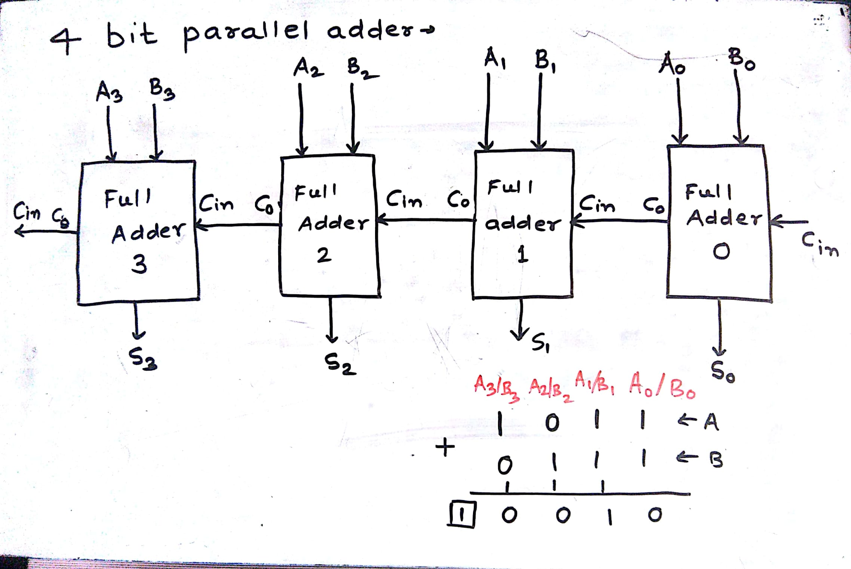
4 bit parallel adder
Department of Computer Engineering

Slide 5
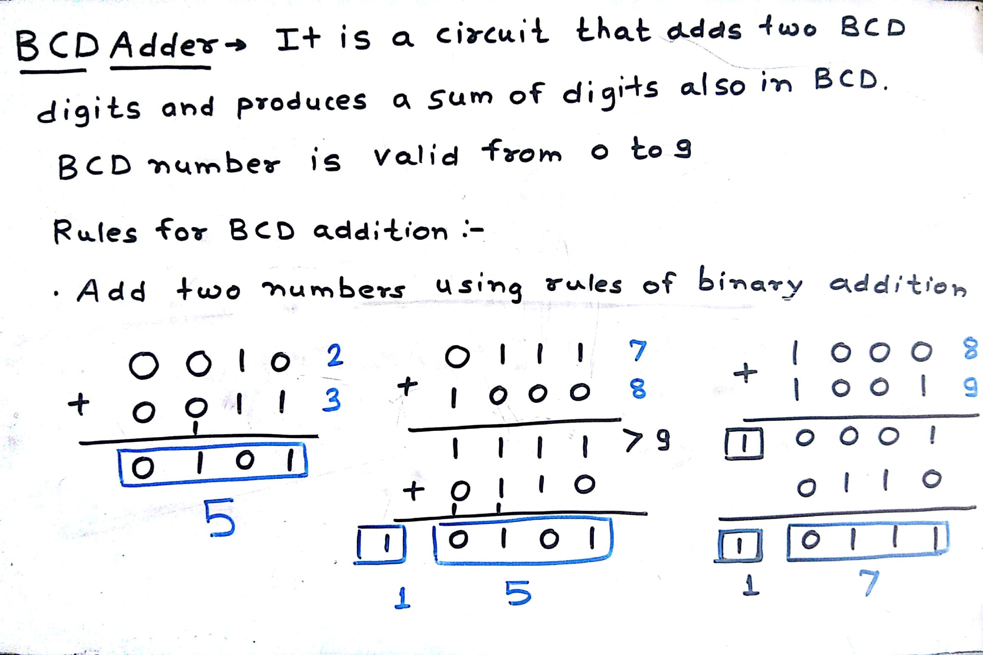
BCD Adder
Department of Computer Engineering

Slide 6
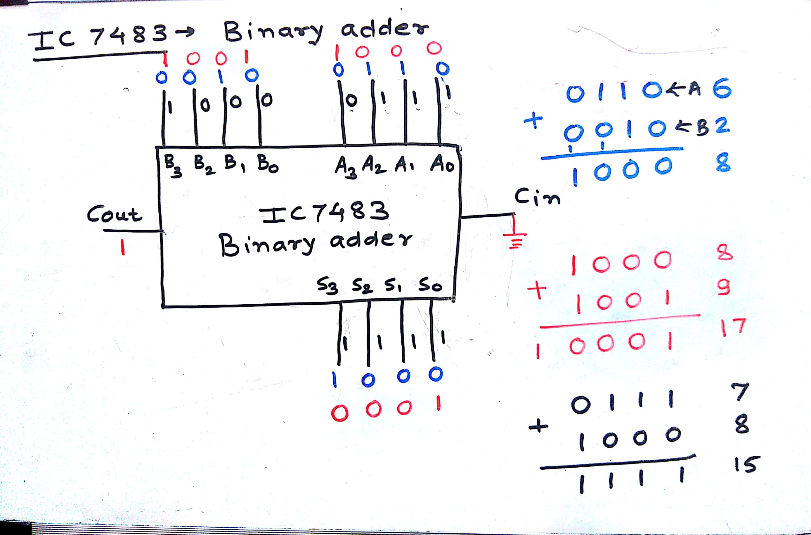
Binary Adder (IC 7483)
Department of Computer Engineering

Slide 7
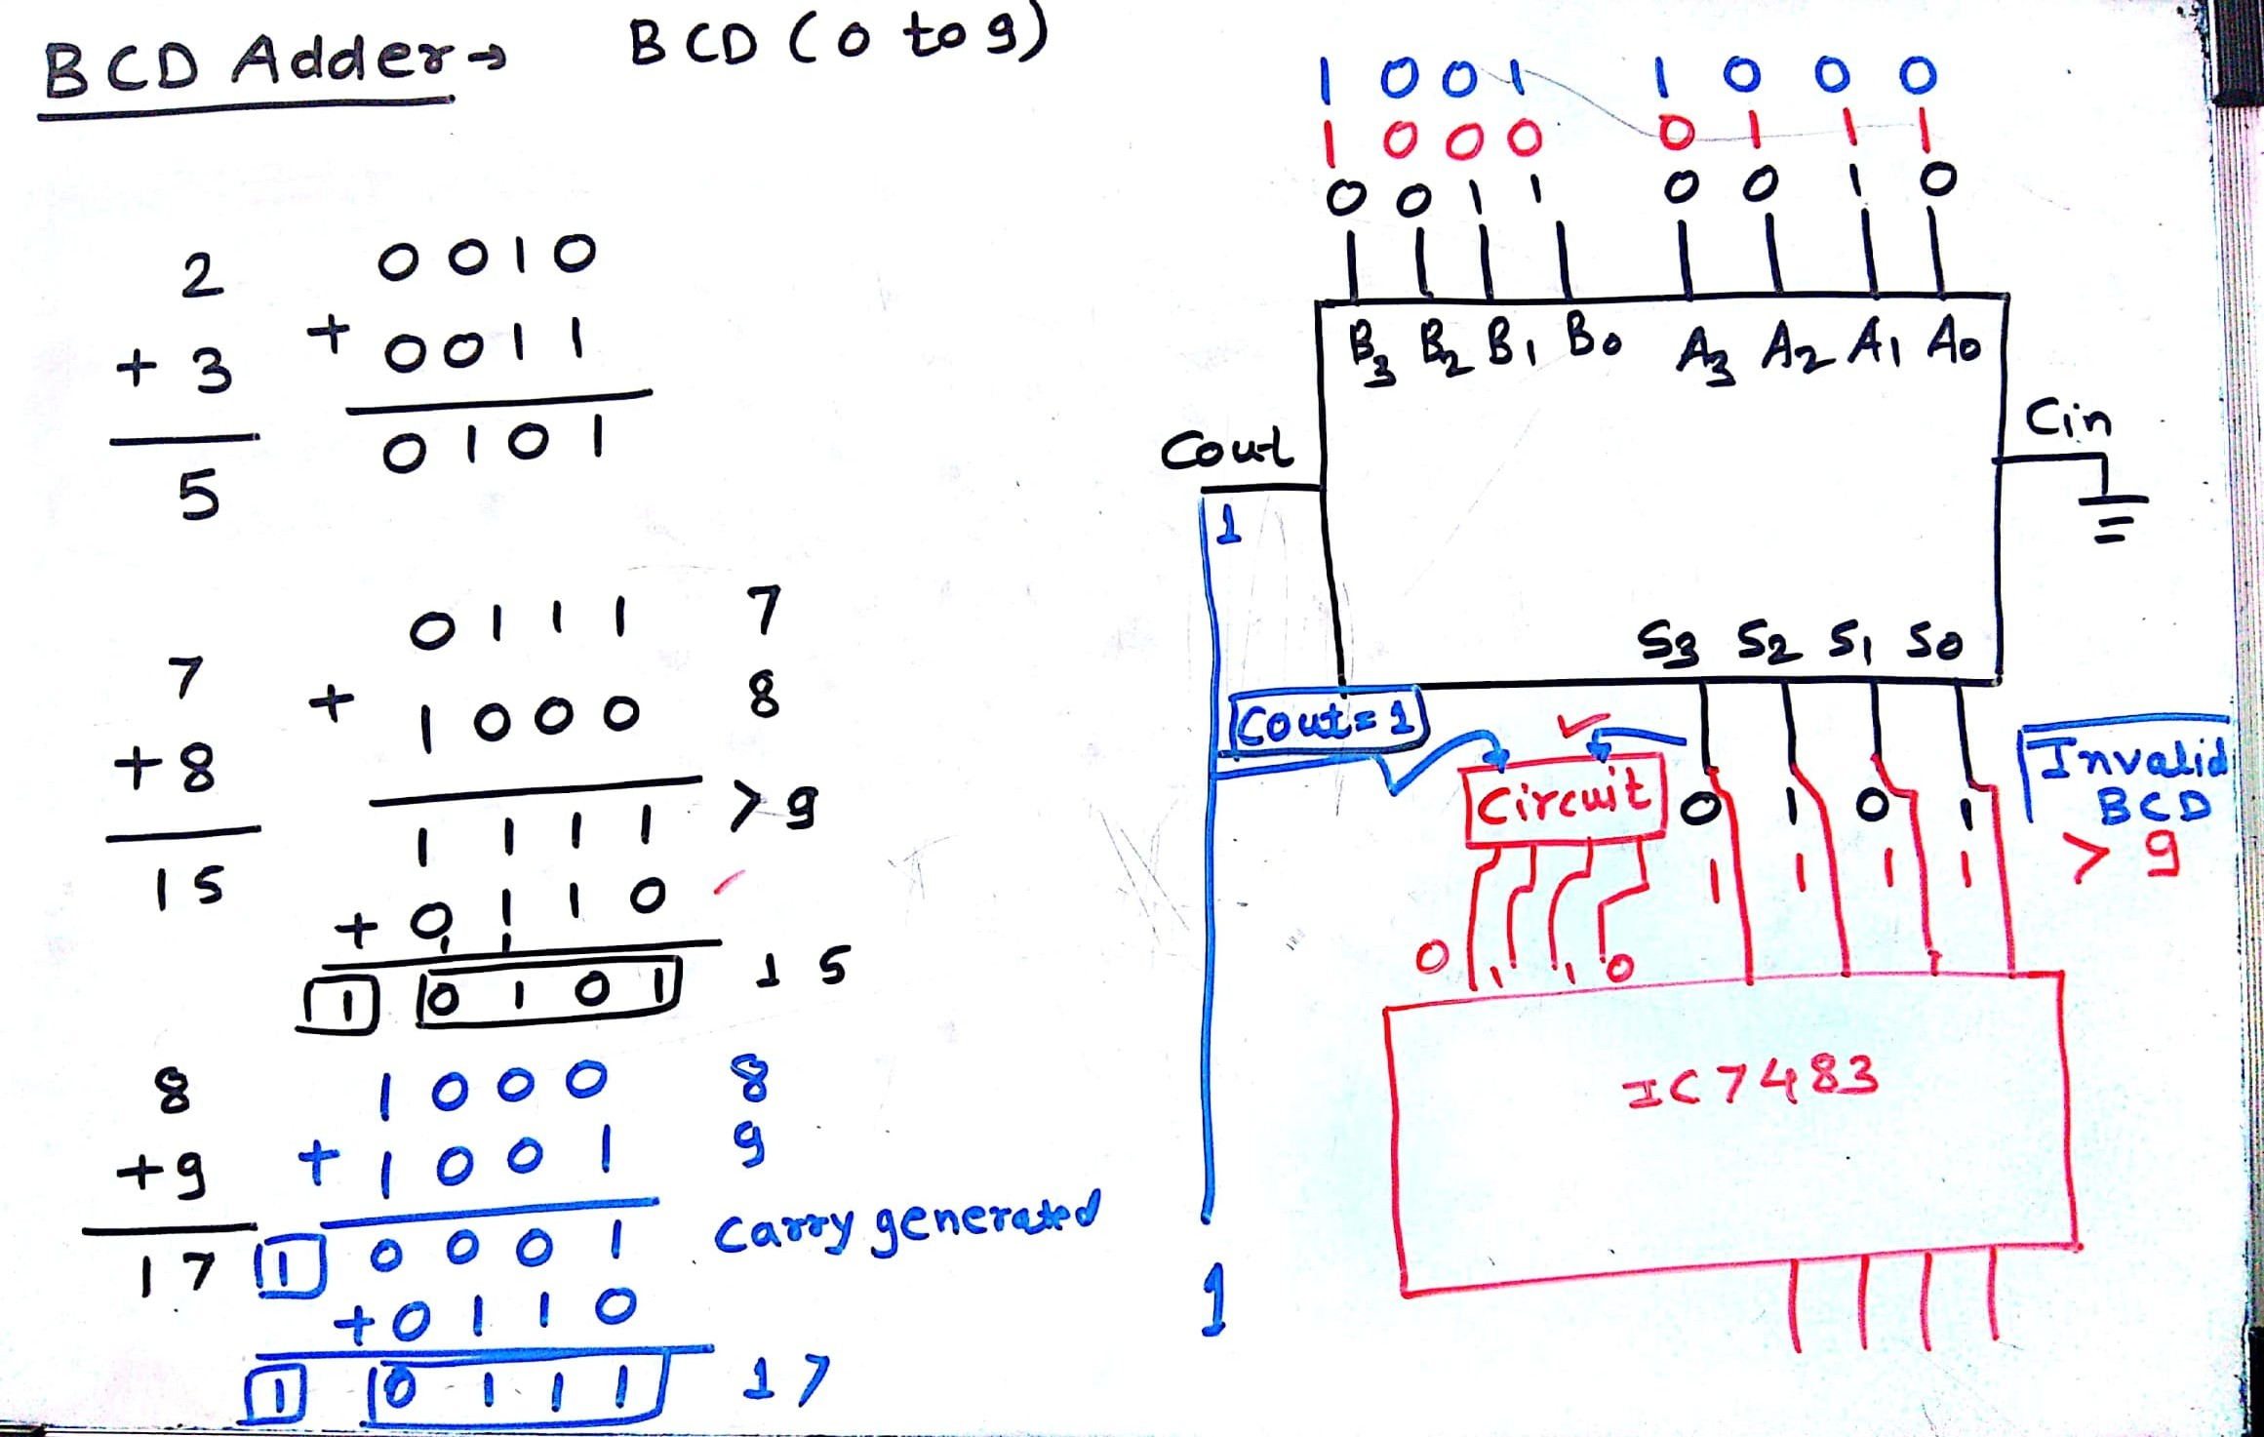
BCD Adder
Department of Computer Engineering

Slide 8
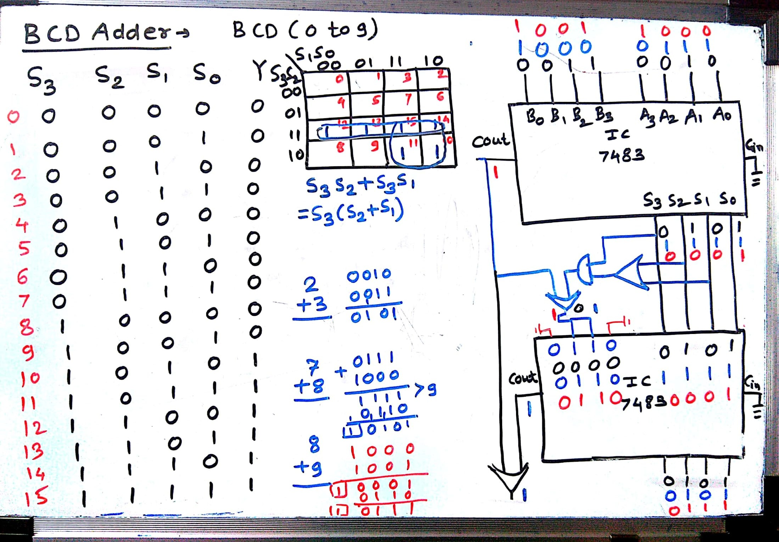
BCD Addition
Department of Computer Engineering

Slide 9
Quiz
Please click the following link to open the quiz
https://forms.office.com/Pages/ResponsePage.aspx?id=PaYKCtCCoUu5CdeYbs5MTF_APCNoJBJKm6RQWrSY69tURUJCVzA0R01PNThQSVlUQ0U5RTA4VFAyNS4u

Slide 10
Points covered
Department of Computer Engineering
4 bit parallel adder
BCD adder
4 bit binary Adder (IC 7483)
BCD Adder using IC 7483
10

Slide 11
Department of Computer Engineering
Thank you

